Slide 1
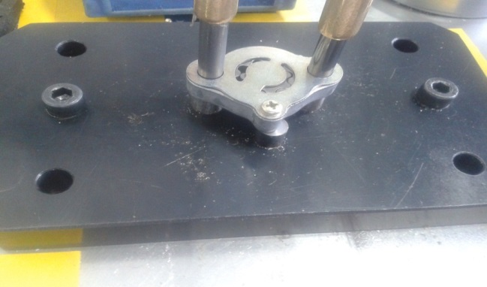
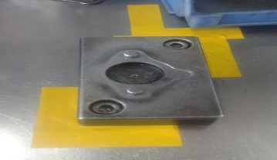
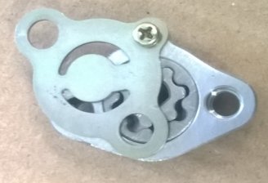
P15
TPM CIRCLE NO :- 01
ACTIVITY
KK
QM
PM
JH
SHE
OT
DM
E&T
KAIZEN IDEA SHEET
TPM CIRCLE NAME: Oil Pump
LOSS NO. / STEP
DEPT :- ASSEMBLY SHOP
RESULT AREA
P
Q
A
C
D
S
M
B
CELL :- A315
CELL NAME:- Oil Pump Assly
MACHINE / STAGE :- Free rotation stage
OPERATION :- Free rotation
KAIZEN THEME : To reduce rejection of plate shift in A315 oil pump.
IDEA :-Fixture design needs to change
COUNTERMEASURE:-
1) To get rigid resting fixture procured with three resting pins
BENCHMARK
1949 Nos
Problem present status :-A315 plate shift found at final inspection stage.
TARGET
0 Nos
KAIZEN START
05.05.2016
KAIZEN FINISH
20.05.2016
TEAM MEMBERS : Dipali Shete, Nitin Sutar
Mohan Kate, Bhavesh Pednekar.
BENEFITS :-
Reduction in in-house rework
Only two pins available for component resting
KAIZEN SUSTENANCE
Before
After
WHY - WHY ANALYSIS :-
Why1 :-A315 plate shift found at final inspection stage.
Why2:-Inadequate fitment on screw in body
Why3 :-body tilt during screw fitment Why4 :-Uneven resting of body on fixture
Why4 :-Fixture design is not according to component
RESULT :-
WHAT TO DO: Verification of three pins existence.
HOW TO DO: JH/ fixture PM
FREQUENCY –Daily /Monthly
SCOPE & PLAN FOR HORIZONTAL DEPLOYMENT
Sr No | CELL | TDC | RESP. | STATUS
1 | All Casting |  | Mr. Nitin sutar | Completed
ROOT CAUSE : Fixture design is not according to component.
REGISTRATION NO. & DATE : 11.05.2016
REGISTERED BY :- Mohan kate
MANAGER’S SIGN :- Sandeep patil

